Slide 1
Chapter 10
Multiprocessor, Multicore, Real-time Scheduling

Slide 2
Multiprocessor Systems
Classification of multiprocessor systems
Loosely coupled or distributed multiprocessor, or cluster
Consists of a collection of systems, each processor having its own main memory and I/O channels.
Functionally specialized processors
Example, I/O processor, controlled by master processor (general-purpose processor) and provides services to it.
Tightly coupled multiprocessor
A set of processors that share a common main memory

Slide 3
Multiprocessor Systems
Issues in multiprocessor scheduling
The assignment of processes to processors
The use of multiprogramming on individual processors
The actual dispatching of a process

Slide 4
Multiprocessor Systems
The assignment of processes to processors
Assuming all processors are equal, it’s simplest to treat processors as a pooled resource and assign processes to processors on demand (statically or dynamically)
Static assignment: a process is permanently assigned to one processor until its completion, a dedicated short-term queue is maintained for each processor.

Slide 5
Multiprocessor Systems
Advantages of static assignment:
may be less overhead in the scheduling function (processor assignment is made once and for all)
allows group or gang scheduling
Disadvantage:
one processor can be idle, with an empty queue, while another processor has a backlog^{Ψ}

Slide 6
Multiprocessor Systems
^{Ψ} To prevent the backlog situation
Use a common queue for all processes, schedule a process to any available processor
A process may be executed on different processors at different times
Use dynamic assignment
threads are moved from a queue for one processor to a queue for another processor (approach used in Linux)

Slide 7
Multiprocessor Systems
Two approaches in assigning processes to processors:
Master-slave
Peer

Slide 8
Multiprocessor Systems
Master-slave architecture
Key kernel functions always run on a particular processor
Other processors may only execute user programs
Master is responsible for scheduling
Slave sends service request to the master
Simple and requires little enhancement to a uniprocessor multiprogramming operating system
Conflict resolution is simplified because one processor controls all memory and I/O resources

Slide 9
Multiprocessor Systems
Master-slave architecture
Disadvantages:
failure of master brings down whole system
master can become a performance bottleneck

Slide 10
Multiprocessor Systems
Peer architecture
Kernel can execute on any processor
Each processor does self-scheduling from the pool of available processes
Complicates the operating system
must ensure that two processors do not choose the same process and
processes are not somehow lost from the queue
required techniques to resolve and synchronise competing claims to resources

Slide 11
Multiprocessor Systems
The use of multiprogramming on individual processors
Should a dedicated processor be multi-programmed?
Depend on granularity of application and number of processors.
Main concern: provide the best performance for applications
Application with multiple threads may run poorly if the threads are unable to run simultaneously

Slide 12
Multiprocessor Systems
Process Scheduling
Usually processes are not dedicated to processors in traditional multiprocessor system
A single queue is used for all processors
if some sort of priority scheme is used, there are multiple queues based on priority
System is viewed as being a multi-server queuing architecture

Slide 13
Multiprocessor Systems
Thread Scheduling
Thread execution is separated from the rest of the definition of a process
An application can be a set of threads that cooperate and execute concurrently in the same address space, can be used to exploit true parallelism in an application

Slide 14
Multiprocessor Systems
Thread Scheduling – 4 approaches:
Load sharing
Gang scheduling
Dedicated processor assignment
Dynamic scheduling

Slide 15
Multiprocessor Systems
Thread Scheduling: Load sharing
Processes are not assigned to a particular processor
Ready threads are placed into a global queue, idle processor will select a thread from the queue
The simplest approach and carries over most directly from a uniprocessor environment

Slide 16
Multiprocessor Systems
Thread Scheduling: Load sharing
Advantages:
Load is distributed evenly across the processors, no processor will be idle if work available
No centralized scheduler required, scheduling routine can run on any available processor
The global queue can be organized and accessed using any of the schemes in Chapter 9

Slide 17
Multiprocessor Systems
Thread Scheduling: Load sharing
Versions of load sharing
First-come-first-served
Smallest number of threads first
Highest priority given to threads from jobs with the smallest number of unscheduled threads, run to completion or blocking
Pre-emptive smallest number of threads first
Highest priority given to jobs with the smallest number of unscheduled threads
Arriving job with a smaller number of threads will pre-empt executing job

Slide 18
Multiprocessor Systems
Thread Scheduling: Load sharing
Disadvantages:
Must enforce mutual exclusion on the central queue, may become a bottleneck
Pre-empted threads are unlikely to resume execution on the same processor - caching becomes less efficient
If all threads are treated as a common pool of threads, it is unlikely that all threads of a program will gain access to processors at the same time - the process switches involved may seriously compromise performance

Slide 19
Multiprocessor Systems
Thread Scheduling: Gang scheduling
Simultaneous scheduling of the threads that make up a single process
Benefits:
reduce synchronization blocking, less process switching, performance will increase
reduce scheduling overhead (single scheduling decision affects a number of processors and processes)

Slide 20
Multiprocessor Systems
Thread Scheduling: Gang scheduling
Useful for medium-grained to fine-grained parallel applications whose performance severely degrades when any part of the application is not running while other parts are ready to run
Beneficial for any parallel application

Slide 21
Multiprocessor Systems
Thread Scheduling: Dedicated Processor Assignment
Each of the threads in an application is assigned to a processor that remains dedicated to that thread until the completion
If a thread is blocked waiting for I/O or synchronization with another thread, then that thread’s processor remains idle - no multiprogramming of processors

Slide 22
Multiprocessor Systems
Thread Scheduling: Dedicated Processor Assignment
Defence of this strategy:
in a highly parallel system, with tens or hundreds of processors, processor utilization is no longer so important as a metric for effectiveness or performance
the total avoidance of process switching during the lifetime of a program should result in a substantial speedup of that program

Slide 23
Multiprocessor Systems
Thread Scheduling: Dedicated Processor Assignment
Experiment with 16 processors

Slide 24
Multiprocessor Systems
Thread Scheduling: Dedicated Processor Assignment
the performance worsens when the number of threads in each application exceeds 8
there is a greater frequency of thread pre-emption and rescheduling

Slide 25
Multiprocessor Systems
Thread Scheduling: Dynamic Scheduling
It is possible to provide language and system tools that permit the number of threads in the process to be altered dynamically - allow the OS to adjust the load to improve utilisation
Both the OS and application are involved in making scheduling decisions
Responsibility of OS: processor allocation
Application performs the scheduling

Slide 26
Multiprocessor Systems
Thread Scheduling: Dynamic Scheduling
Policy for processor allocation, when a job requests one or more processors
Use idle processors to satisfy the request
If new arrival, allocate a processor taken from any job currently allocated more than one processor
If any portion of the request cannot be satisfied, it remains outstanding until either a processor is available or the request is cancelled

Slide 27
Multiprocessor Systems
Thread Scheduling: Dynamic Scheduling
Policy for processor allocation, when a job requests one or more processors
When processor(s) available, assign a processor to each new arrival job that has no processors. Then, allocate the rest of the processors on an FCFS basis.
Dynamic scheduling is superior to gang scheduling or dedicated processor assignment for applications that can take advantage of it

Slide 28
Multiprocessor Systems
Thread Scheduling: Multicore Thread Scheduling
Treat in the same fashion as a multiprocessor system
Number of cores per chip increases, use of caches to take advantage of locality will take precedence over the desire to maximize processor utilisation
Some cache architectures complicates the approach, for example, AMD Bulldozer chip

Slide 29
Multiprocessor Systems
Thread Scheduling: Multicore Thread Scheduling
L2 cache shared by adjacent cores
E.g. Core 1 & 2, 3 & 4, etc.
AMD Bulldozer Architecture

Slide 30
Multiprocessor Systems
Thread Scheduling: Multicore Thread Scheduling
Intel Core i7-990X Block Diagram

Slide 31
Multiprocessor Systems
Thread Scheduling: Multicore Thread Scheduling
2 aspects of cache sharing to be concerned:
Cooperative resource sharing
Multiple threads access the same set of main memory locations. Examples:
applications that are multithreaded
producer-consumer thread interaction
Schedule cooperating threads on adjacent cores

Slide 32
Multiprocessor Systems
Thread Scheduling: Multicore Thread Scheduling
2 aspects of cache sharing to be concerned:
Resource contention
Threads that are operating on adjacent cores, compete for cache memory locations
If more cache is dynamically allocated to one thread, the competing thread has less cache space available and thus suffers performance degradation
Objective of contention-aware scheduling is to allocate threads to cores to maximize the effectiveness of the shared cache memory

Slide 33
Real-Time Systems
Examples:
Control of laboratory experiments
Process control in industrial plants
Robotics
Air traffic control
Telecommunications
Military command and control systems

Slide 34
Real-Time Systems
Correctness of the system depends not only on the logical result but also on the time at which the results are produced
Real-time tasks or processes attempt to control or react to events that take place in the outside world
tasks must be able to keep up with the events

Slide 35
Real-Time Tasks
A real time task is associated with a deadline, either a start time or a completion time.
Hard real-time task – must meet its deadline, otherwise it will cause unacceptable damage or a fatal error to the system
Soft real-time task – associated with deadline but not mandatory.
Still makes sense to schedule and complete the task even if it has passed its deadline

Slide 36
Real-Time Tasks
Periodic tasks – requirement may be stated as
once per period T
exactly T units apart
Aperiodic tasks
has a deadline by which it must finish or start
may have a constraint on both start and finish time

Slide 37
Characteristics of Real-Time Systems
Determinism
Responsiveness
User control
Reliability
Fail-soft operation

Slide 38
Characteristics of Real-Time Systems
Determinism
Operations are performed at fixed, predetermined times or within predetermined time intervals
no system will be fully deterministic when multiple processes are competing for resources and processor time
The extent to which an OS can deterministically satisfy requests depends on:
the speed to respond to interrupts
capacity to handle all requests within the required time

Slide 39
Characteristics of Real-Time Systems
Determinism
Concerned with how long the OS delays (a few microseconds to a millisecond) before acknowledging an interrupt

Slide 40
Characteristics of Real-Time Systems
Responsiveness
Concern with how long the OS takes to service the interrupt after acknowledgment
critical for real-time systems that must meet timing requirements imposed by individuals, devices, and data flows external to the system
Includes
amount of time to start execution of ISR (Interrupt Service Routine)
amount of time to perform the ISR
effect of interrupt nesting (ISR is interrupted)

Slide 41
Characteristics of Real-Time Systems
User control
Allow user fine-grained control over task priority
User should be able to distinguish between hard and soft tasks and specify relative priorities within each class
May allow user to specify such characteristics as:
paging or process swapping
what processes must always be resident in main memory
disk transfer algorithms to be used
processes rights in various priority bands

Slide 42
Characteristics of Real-Time Systems
Reliability
Degradation of performance may have catastrophic consequences (equipment damage, financial loss, loss of life)
Fail-soft operation
Ability of a system to fail in such a way as to preserve as much capability and data as possible
Important aspect: Stability
system will meet the deadlines of its most critical, highest-priority tasks even if some less critical task deadlines are not always met

Slide 43
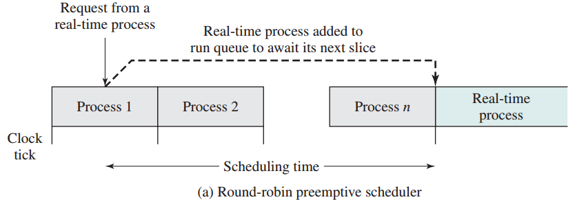
Real-Time Scheduling
Round-robin: real-time task would be added to the ready queue to await its next time slice
unacceptable for real-time applications

Slide 44
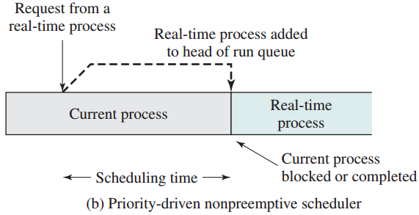
Real-Time Scheduling
Non pre-emptive scheduling, priority based
giving real-time tasks higher priority
ready task is scheduled as soon as the current process blocks or completes – lead to unacceptable delay if a slow, low-priority task were executing at a critical time

Slide 45
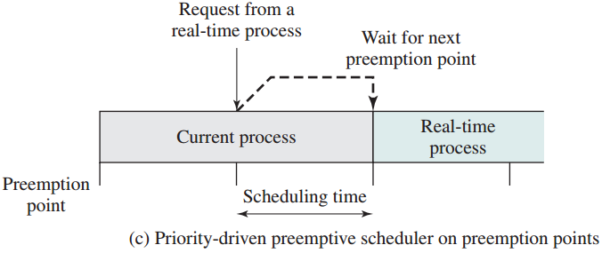
Real-Time Scheduling
Combine priority with clock-interrupt
When a pre-emption point occurs (at regular intervals), currently running task is pre-empted if a higher-priority task is waiting – not suffice for more demanding applications

Slide 46
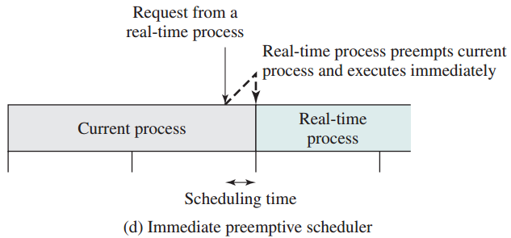
Real-Time Scheduling
Combine priority with clock-interrupt
Another variant – immediate pre-emption
responds to an interrupt almost immediately, unless the system is in a critical-code lockout section, delays ≤100μs

Slide 47
Real-Time Scheduling
Scheduling approaches depend on:
whether a system performs schedulability analysis
if yes, whether it is done statically or dynamically
whether the result of the analysis itself produces a scheduler plan

Slide 48
Real-Time Scheduling
Classes of scheduling algorithms:
Static table-driven approaches
performs a static analysis of feasible schedules of dispatching
result is a schedule that determines, at run time, when a task must begin execution
applicable to periodic task
analysis input: arrival time, execution time, ending deadline, and priority
inflexible, any change to any task requires the schedule be redone

Slide 49
Real-Time Scheduling
Classes of scheduling algorithms:
Static priority-driven preemptive approaches
A static analysis is performed but no schedule is drawn up
Analysis is used to assign priorities to tasks, traditional priority-driven preemptive scheduler can be used

Slide 50
Real-Time Scheduling
Classes of scheduling algorithms:
Dynamic planning-based approaches
feasibility is determined at run time
one of the analysis results is a schedule to decide when to dispatch this task
If a new arrival can be scheduled in such a way that its deadlines are satisfied and no currently scheduled task misses a deadline, the schedule is revised to accommodate the new task

Slide 51
Real-Time Scheduling
Classes of scheduling algorithms:
Dynamic best effort approaches
Aperiodic task, static analysis is not possible
System tries to meet all deadlines and aborts any started process whose deadline is missed
Disadvantage: do not know whether a timing constraint will be met
Advantage: easy to implement

Slide 52
Deadline Scheduling
Real-time operating systems are designed to start real-time tasks as rapidly as possible and emphasize rapid interrupt handling and task dispatching
not concerned with speed but with completing tasks

Slide 53
Deadline Scheduling
Information used for scheduling
Ready time
Starting deadline
Completion deadline
Processing time
Resource requirements
Priority
Subtask scheduler - a task may be decomposed into subtasks

Slide 54
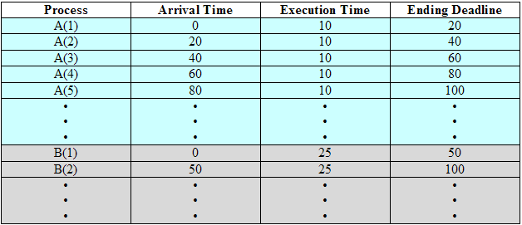
Deadline Scheduling – Example
Deadline for A is 20ms and 50ms for B
Scheduling decision is made every 10ms

Slide 55
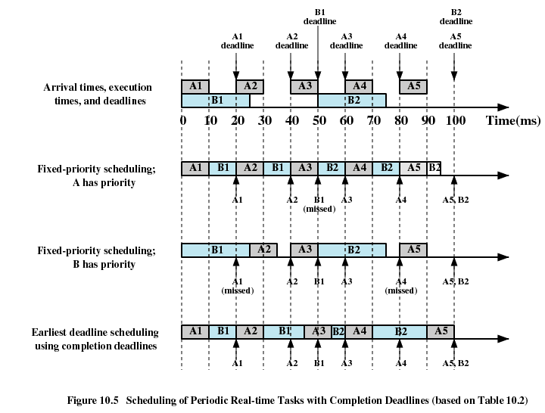
Deadline Scheduling – Example (Periodic)

Slide 56
Deadline Scheduling – Example (Periodic)
Tasks are periodic and predictable, a static table-driven scheduling approach can be used

Slide 57
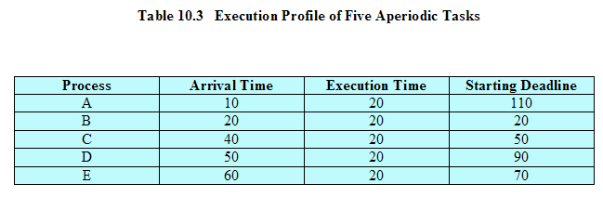
Deadline Scheduling – Example (Aperiodic)

Slide 58
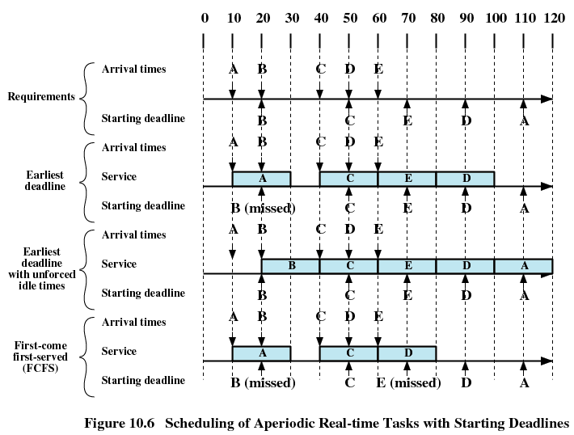
Deadline Scheduling – Example (Aperiodic)
Schedule ready task with the earliest deadline

Slide 59
Deadline Scheduling – Example (Aperiodic)
Schedule eligible task (might not be ready) with the earliest deadline – processor may not fully utilised

Slide 60
Rate Monotonic Scheduling
Task period, T, is the amount of time between the arrival of 1 instance of the task and the arrival of the next instance of the task
Assigns priorities to tasks on the basis of their periods – highest priority task is the one with the shortest period
Task’s rate = 1/T

Slide 61
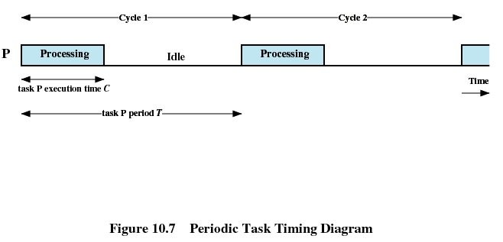
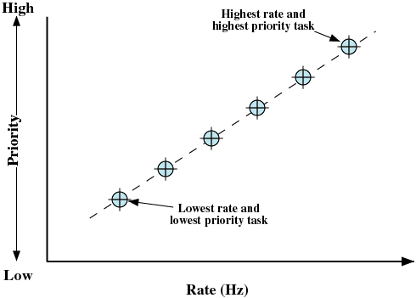
Rate Monotonic Scheduling

Slide 62
Priority Inversion
Can occur in any priority-based preemptive scheduling scheme
Occurs when circumstances within the system force a higher priority task to wait for a lower priority task
Occurred in the Mars Pathfinder mission
rover robot landed on Mars and began gathering and transmitting data back to Earth
Few days later, the software began experiencing total system resets, each resulting in losses of data

Slide 63
Priority Inversion
Unbounded Priority Inversion
the duration of a priority inversion depends not only on the time required to handle a shared resource, but also on the unpredictable actions of other unrelated tasks
Experienced by the Pathfinder software.

Slide 64
Priority Inversion
3 tasks in Pathfinder, in decreasing priority order
T1: Periodically checks the health of the spacecraft systems and software
T2: Processes image data
T3: Performs an occasional test on equipment status
After T1 executes, it reinitializes a timer to its maximum value.

Slide 65
Priority Inversion
If timer expires, the processor is halted, all devices are reset, the software is completely reloaded, the spacecraft systems are tested, and the system starts over
T1 and T3 share a common data structure, protected by a binary semaphore s
The sequence of execution that causes the unbounded priority inversion is shown in the diagram

Slide 66
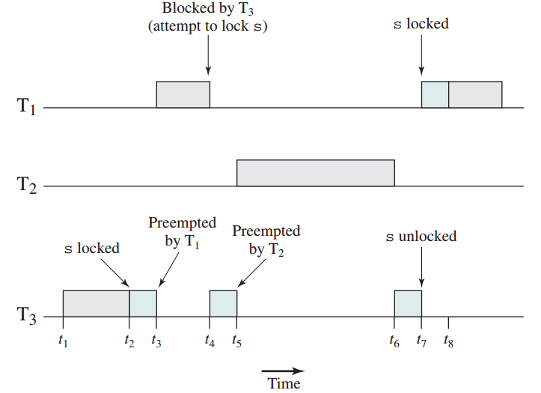
Priority Inversion
T1 must wait for both T3 and T2 to complete and fails to reset the timer before it expires.

Slide 67
Priority Inversion
2 approaches to avoid unbounded priority inversion:
priority inheritance
lower-priority task inherits the priority of any higher-priority task pending on a resource they share
priority ceiling
each resource is associated with a priority which is one level higher than the priority of its
any task accesses that the resource will be assigned with the priority and returns to normal priority once it finishes

